Slide 1
Tarcowie Landcare Group
The story of an enduring country city partnership
Marc Ó Conaill

Slide 2
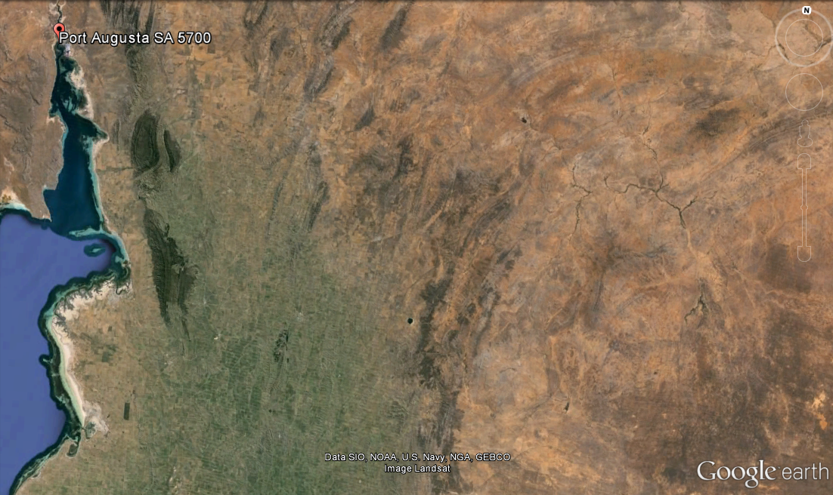
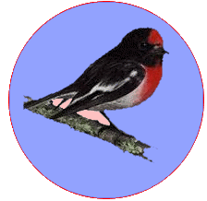
71
72
73
74
75
76
77
78
79
80
61
62
63
64
65
66
67
68
69
70
51
52
53
54
55
56
57
58
59
60
41
42
43
44
45
46
47
48
49
50
31
32
33
34
35
36
47
38
39
40
21
22
23
24
25
26
27
28
29
30
11
12
13
14
15
16
17
18
19
20
1
2
3
4
5
6
7
8
9
10

Slide 3
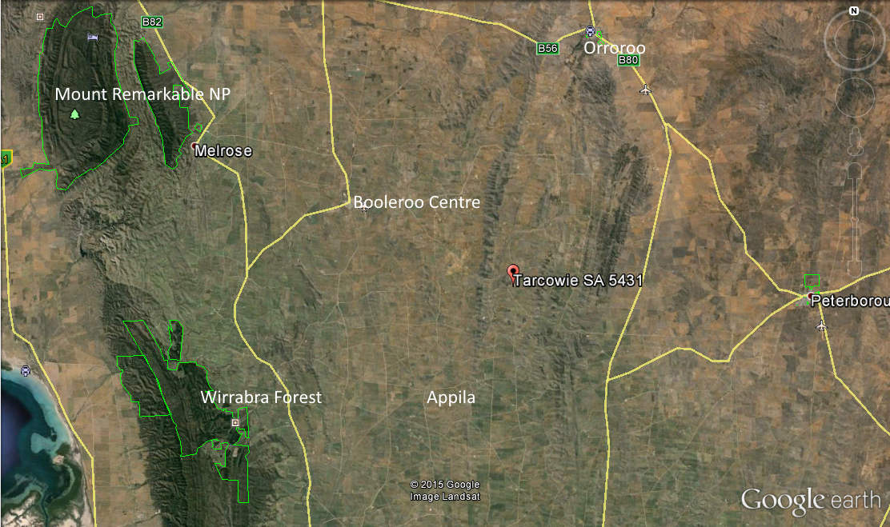

Slide 4
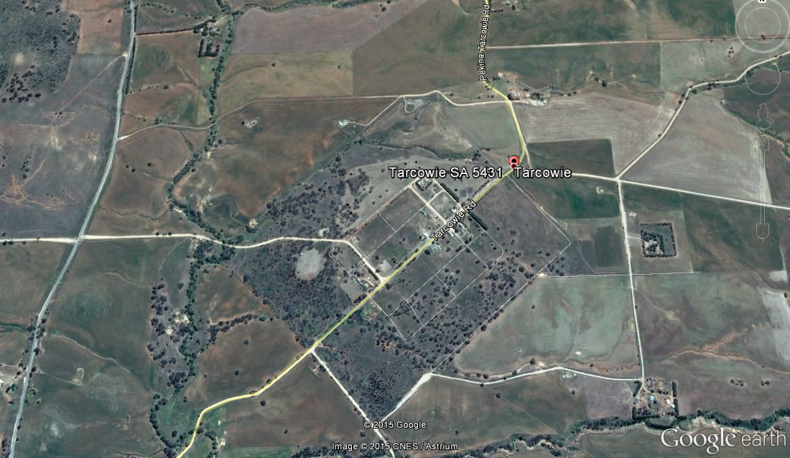
Tarcowie – The place of wash away water

Slide 5
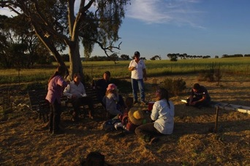
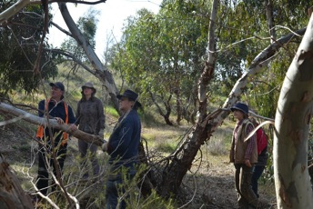
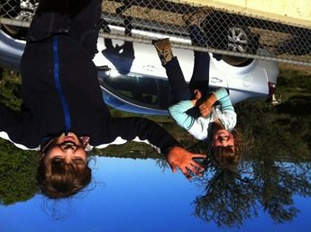
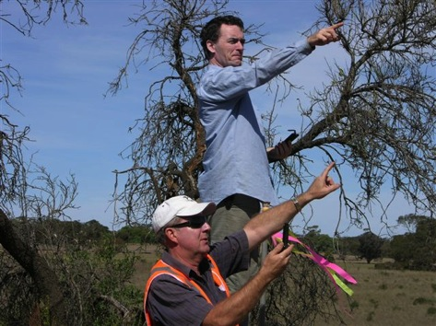
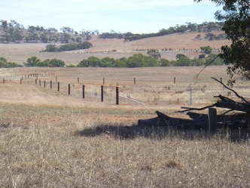
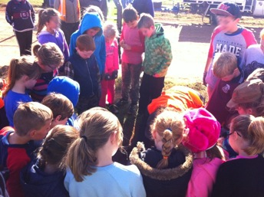
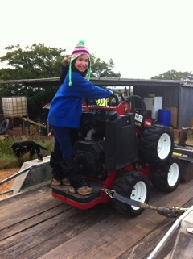
Tarcowie Landcare Group …
HAVE NO MOBILE PHONE RECEPTION
… socialises to bind and share
… uses every opportunity to learn
… is a fun place to grow and explore safely
… employs tried and tested models
… engages with the community, especially the future
… is supported by business
Notes:
Olearia picridifolia. EPBC rating - SA rare / Flinders Ranges vulnerable

Slide 6
Some Achievements
12,000 plants along 19km of roadside
3 donated blocks revegetated
Tarcowie Springs fenced and revegetated
Dump rehabilitated and revegetated
Significant weeds eradicated
$50,000 in-kind contribution per year
Notes:
Biolink – revegetation of Caltowie & Price Maurice Road (Formerly Stagg Road). To date over 12,000 plants have been planted along a 19km stretch of roadside. This project, in conjunction with Variety SA & local schoolchildren, will continue into the future.
Revegetation of three blocks of land kindly donated to the group by a local community member and supporter.
With NRM funding and approval from Northern Areas Council, Tarcowie Springs has been fenced and revegetated. Regeneration has been remarkable now that stock has been removed.
Porosa Block (pt Section 329), the Tarcowie Dump and quarry sites have been revegetated with approval from Northern Areas Council.
Weed control working bees have eradicated sites infested with Boxthorn. Work continues to eradicate Peppercorn trees, Rice Millet, Horehound, Aleppo Pile, Scabiosa, Gazania, Soursob, Statice etc. Native plants actually help to suppress wild oats and other weeds, thus reducing fire risk.
Possum boxes have been installed to encourage a healthy possum population to aid in the reduction of Mistletoe infestation.
Revegetation projects have been carried out on several private properties. Activities include fencing, tubestock planting, weed control. Direct sowing in some areas has also been very successful.
Our group has assisted with funding applications for projects to fence and rehabilitate areas of remnant vegetation. We can also assist with plant identification and advice.
Seed collection plays a major part in revegetation projects. Seed is collected by members of the group with seed collecting permits to ensure only local seed is used for tubestock and direct sowing.
Watering plantings for the first year ensures a high success rate. Not the most popular task during summer months, but well worth the effort.
Bat boxes have been installed and are being monitored.
Programs to eradicate pest animals have been undertaken & will continue to be a priority
Plant identification & photo records are maintained to monitor populations of rare & threatened plants. Photo points have been installed at all revegetation sites to maintain a record of development
Signage has been erected at all our project sites

Slide 7
Tarcowie Dump 2009 (before closure)

Slide 8
Tarcowie Dump 2015

Slide 9
Challenges (and some Solutions)
NRM funding model is problematic
Retaining NRM staff
Values can clash
Some use of public land is questionable
Project sites hard to come by
Distances are great
Harsh environment for revegetation and work

Slide 10
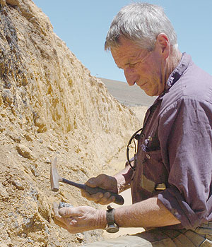
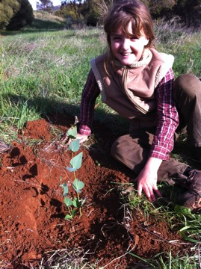
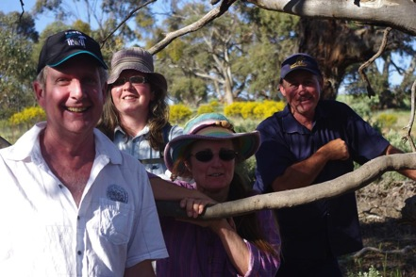
Voices of TLG
Gráinne Ní Chonaill
young member
“Canoee” Catford
landholder
Kieran Brewer (R)
founder

Slide 11
Questions

